Slide 1

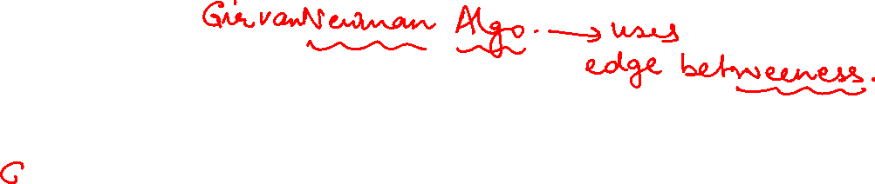
Graph Theory and Its Applications
Community Detection
Dr. Arti Arya
Department of Computer Science
and Engineering

Slide 2

Graph Theory and its Applications
Girvan Newman Algorithm – Group based community detection
Dr. Arti Arya
Department of Computer Science and Engineering

Slide 3
Graph Theory And its Applications Disclaimer
The course slides are prepared by Prof. BhaskarJyoti. But various major inputs are added by me from various reliable resources from Foreign and Indian Universities as well as from sites.
Notes:
Ok. Having said that, lets get back to what we were speaking about.
Input devices. We have seen that the virtual reality eco system largely encompasses three fundamental components that include
HMD – head mounted devices that give you immersive VR experience, we saw some examples in the last class like the HTC VIVE, Oculus Rift, Samsung gear and so on. Some of you have also used few of these and experienced it for a few minutes.
And the second components is the GTD or the Gesture Tracking Devices. We saw a video of Xsense IMU sensors that can accurately estimation the position and orientation of a dancer. we will in the next hour see how these gesture tracking devices work and what are the various technicalities that go into tracking. I will try to keep it as non-mathematical as possible, as the mathematics behind it can get pretty messy and complicated. However, if you are interested in the mathematical aspects, I will be more than happy to discuss.
On the screen you can see that a 3 directional coordinate system is depicted. The 3 primary axes of a 3d coordinate system is X, Y and Z axis. Hear I would like to know where, when and why in your past have you encountered 3 dimensional coordinate system.
Give some time to the students to ponder on
Ok, if I tell you, I have encountered 2 dimension in images, drawings, sketch and so on. While I have encountered 1 dimension when I want to know the temperature currently or current time or something like that. Similar, where and when have you encountered 3D, either consciously or subconsciously.
Explain the roll pitch and yaw concepts.
Degree of freedom

Slide 4
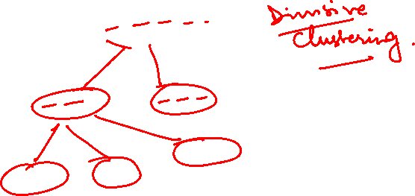
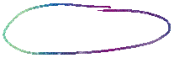
Girvan Newman Algorithm for Community Detection
A quick review of hierarchical clustering

Slide 5
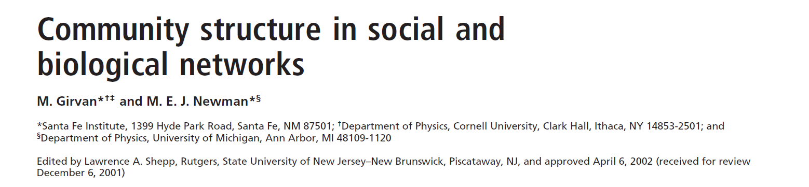
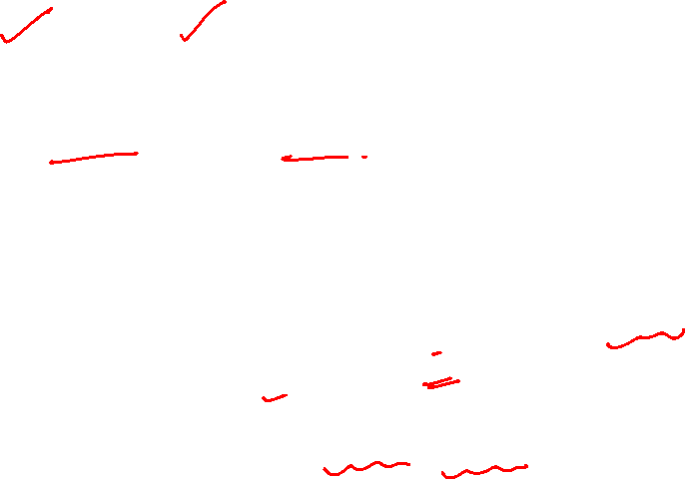
Girvan Newsman Algorithm for Community Detection
https://www.ncbi.nlm.nih.gov/pmc/articles/PMC122977/
17,000+ citations
This method was proposed to side step the shortcomings of traditional hierarchical clustering approach and was successfully tested on both real world and synthetically generated networks
Uses a concept of edge betweenness.

Slide 6
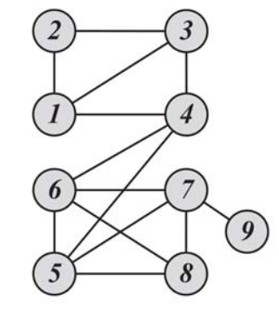
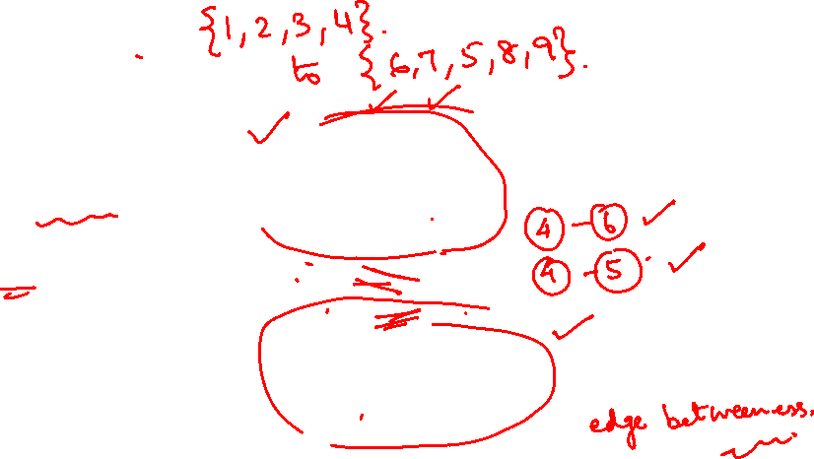
Newman Girvan Algorithm
The idea behind Newman Girvan Algo is:
If a n/w has a set of communities and these communities are connected to each other with few edges, then all shortest paths between members of different communities should pass thru these edges.
By removing these edges we can obtain communities in the n/w

Slide 7
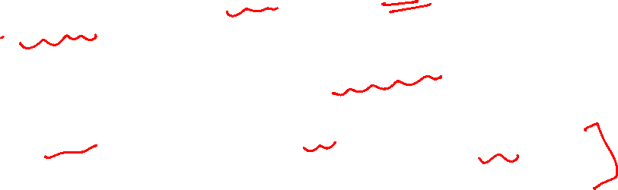
Edge betweenness
Edge betweenness is the number of shortest paths that pass along with the edge
Edge betweenness measures the “bridgeness” of an edge between two communities
The edge with high betweenness tends to be the bridge between two communities.

Slide 8
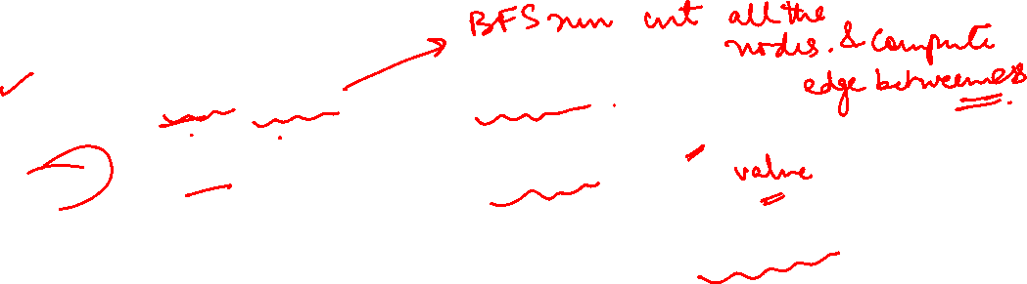
The Girvan Newman Algorithm
Calculate edge betweenness for all edges in the graph.
Remove the edge with the highest edge betweenness.
Recalculate betweenness for all edges affected by the edge removal (unaffected edges need not be recalculated)
Repeat step 2 until no edges remain.
Note : check networkx for an available implementation
Divisive hierarchical clustering.
To determine weakest links, the algorithm uses edge betweenness.
.

Slide 9
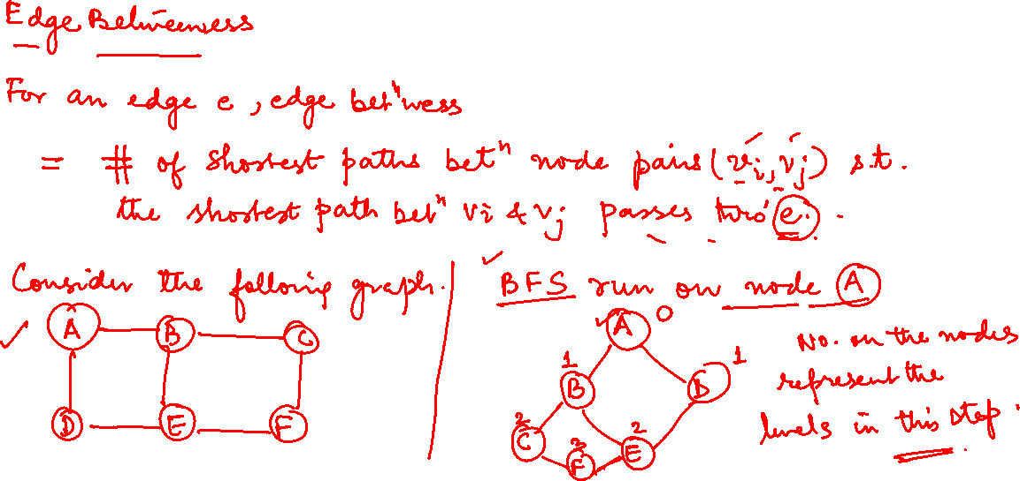
The Girvan Newman Algorithm: Example

Slide 10
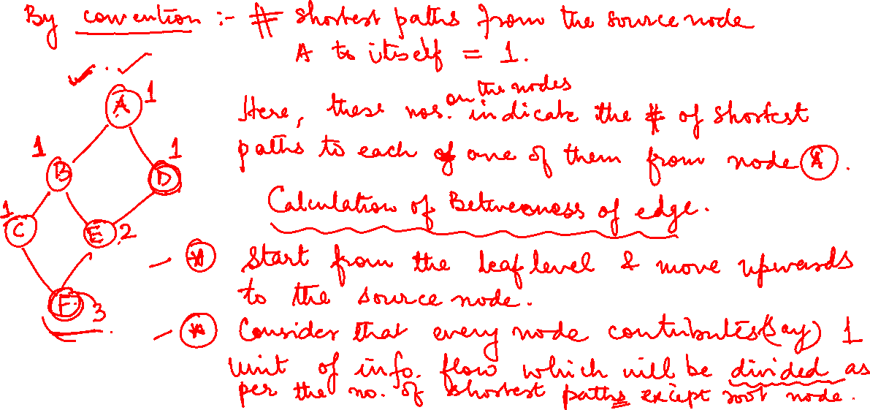
The Girvan Newman Algorithm: Example

Slide 11
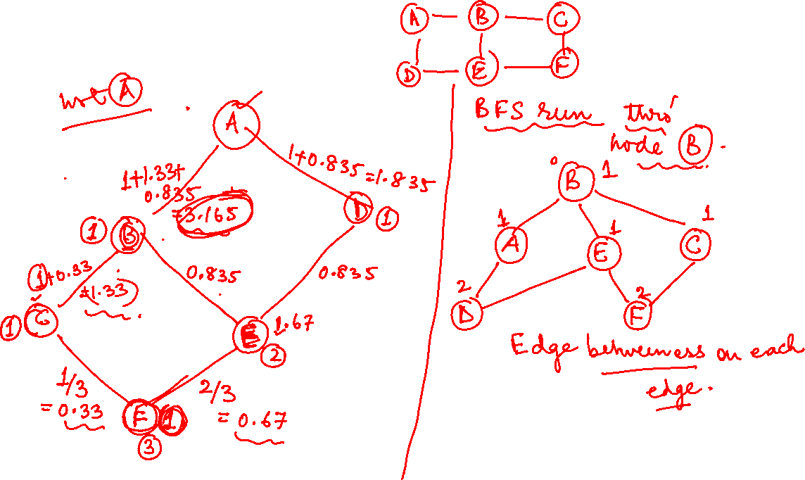
The Girvan Newman Algorithm: Example

Slide 12
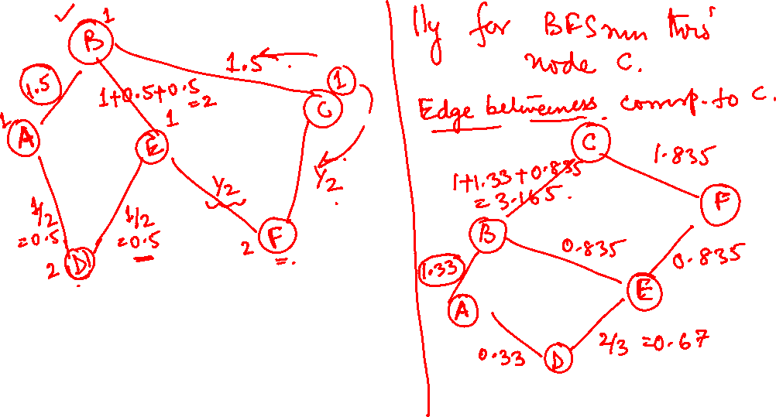
The Girvan Newman Algorithm: Example

Slide 13
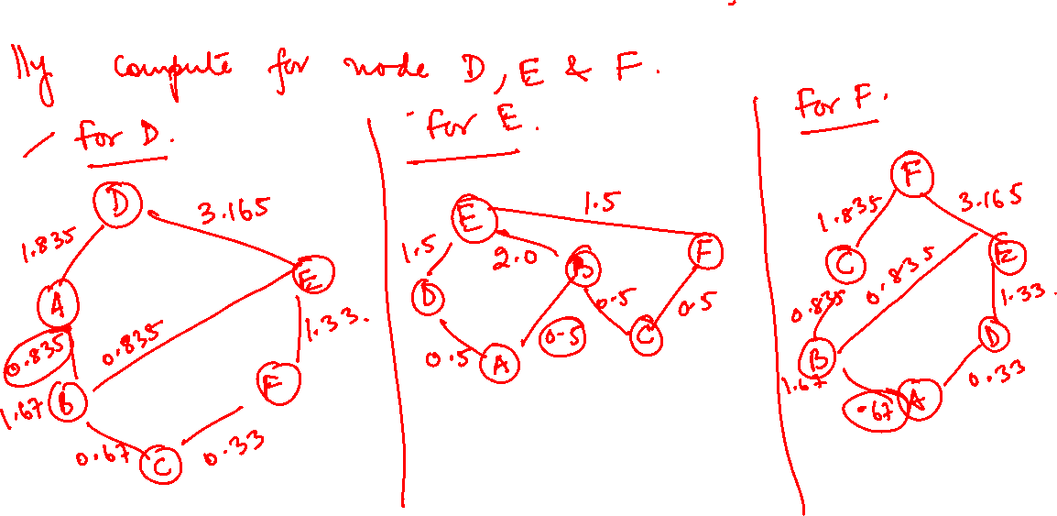
The Girvan Newman Algorithm: Example

Slide 14
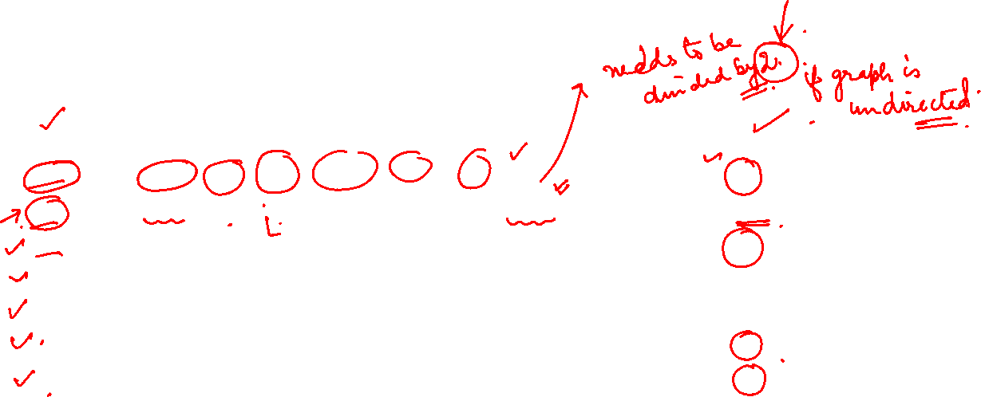
The Girvan Newman Algorithm: Example
Edge | Total Edge Betwenness | Final
AB | 3.165+1.5 +1.33 + 0.835 + 0.5 + 0.667 = 8 | 4
AD | 1.835+0.5 + 0.33 + 1.835+0.5 + 0.33 = 5.33 | 2.67
BC | 3.165+1.5+ 1.33 +0.835+0.5+0.667 = 8 | 4
BE | 0.835+2+0.835+0.835+2+0.835 = 7.34 | 3.67
CF | 1.835+0.5+0.33+1.835+0.5+0.33 =5.33 | 2.67
DE | 3.165+1.5+1.33+0.835+0.5+0.667= 8 | 4
EF | 3.165+1.5 + 1.33+ 0.835+0.5 + 0.667 = 8 | 4

Slide 15
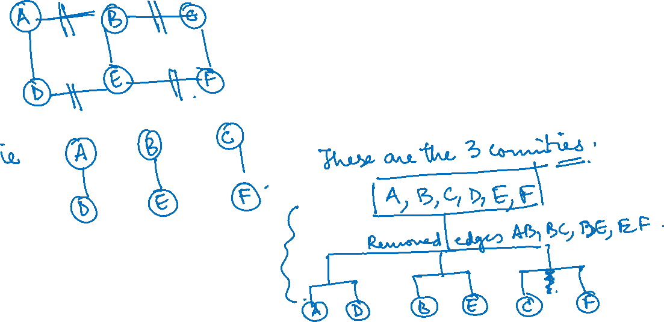
NETWORK ANALYSIS AND MINING
The Girvan Newman Algorithm: Example

Slide 16
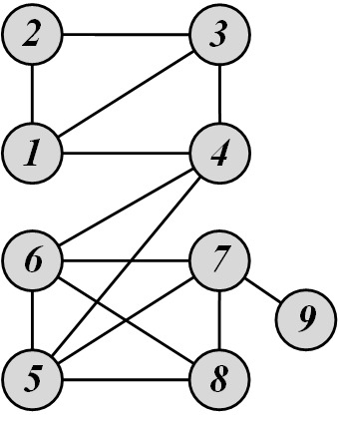
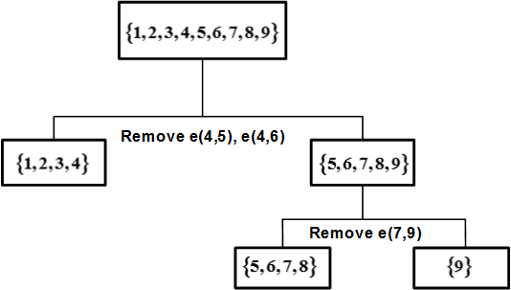
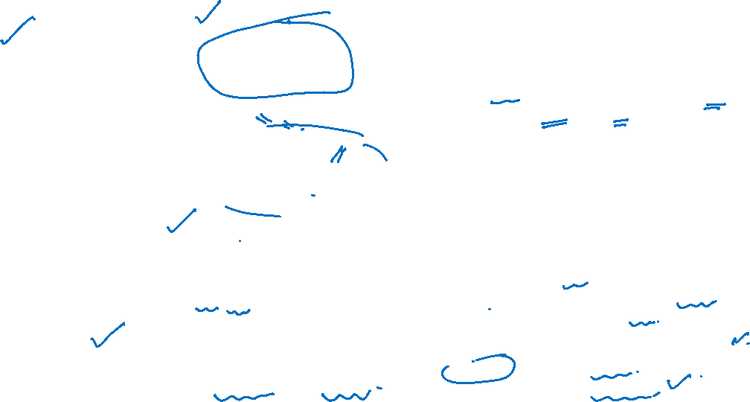
Using edge betweenness
Note : we will give simpler example in test (if at all) where edge for max betweenness can be found out visually
By visual inspection, the first edge that needs to be removed is e(4, 5) or e(4, 6)
After removing e(4, 5), we compute the edge betweenness once again; this time, e(4, 6) has the highest betweenness value: 20.
This is because all shortest paths between nodes {1,2,3,4} to nodes {5,6,7,8,9} must pass e(4, 6);
therefore, it has betweenness 4*5 = 20.

Slide 17

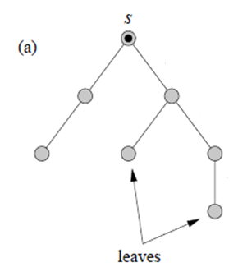
SOCIAL NETWORK ANALYTICS
Community Detection: Girvan–Newman
Breadth-first search can find shortest paths from a single vertex s to all others in time O(m).
In the simplest case, when there is only a single shortest path from the source vertex to any other the resulting set of paths forms a shortest path tree—see Fig. a.

Slide 18
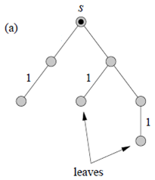
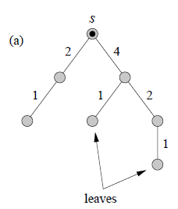
SOCIAL NETWORK ANALYTICS
Community Detection: Girvan–Newman
Use this tree to calculate the contribution to betweenness for each edge from this set of paths as follows.
Find first the “leaves” of the tree, i.e., those nodes such that no shortest paths to other nodes pass through them, and assign a score of 1 to the single edge that connects each to the rest of the tree, as shown in the figure.
Then, starting with those edges that are farthest from the source vertex on the tree, i.e., lowest in Fig. a, we work upwards, assigning a score to each edge i.e. 1 plus the sum of the scores on the neighboring edges immediately below it.
When we have gone though all edges in the tree, the resulting scores are the betweenness counts for the paths from vertex s.
Repeating the process for all possible vertices s and summing the scores, we arrive at the full betweenness scores for shortest paths between all pairs.

Slide 19
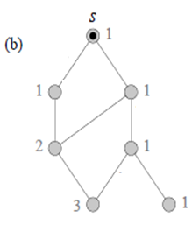
SOCIAL NETWORK ANALYTICS
Community Detection: Girvan–Newman
For cases in which there is more than one shortest path to some vertices, the calculation is more complex.
First we must calculate the number of paths from the source to each other vertex (numbers on vertices), and then these are used to weight the path counts appropriately.

Slide 20
SOCIAL NETWORK ANALYTICS
Community Detection: Girvan–Newman
Calculation of shortest-path betweenness for each edge (for a given root node to all other nodes in the graph) :
step 1 – assign levels using BFS
step 2 – calculate # of shortest paths for node considering its predecessors in the previous level
step 3 – calculate betweenness of each edge starting from leaf level to the root node

Slide 21
SOCIAL NETWORK ANALYTICS
Girvan–Newman example : step 1 – assign levels using BFS
0
A
B
C
Source node
A
1
D
B
1
D
E
F
E
2
2
C
F
3

Slide 22
SOCIAL NETWORK ANALYTICS
Girvan–Newman example : step 1 – assign levels using BFS
Start with source node A and use BFS
A is at level 0
B and D are directly connected with A in a single hop: level 1
From B, we go to C & E ( 1 more hop) : level 2
From B and E , we can go to F is connected (1 more hop): level 3

Slide 23
SOCIAL NETWORK ANALYTICS
Girvan–Newman example : step 2 – calculate # of shortest paths
By convention, #shortest paths from source node A to itself : 1
We go to next level node iteratively where no of shortest paths = sum of # shortest paths of the predecessors at the previous levels
For B , predecessor is A . So, #SP for B = 1 , similarly for D
For E, predecessors at previous level are B and D. So, #SP for E = 2
For C, predecessors at previous levels is B. So, #SP for C = 1
For F, predecessors at previous levels are C and E. So, #SP for F = 3
1
A
Source node
1
D
B
1
E
2
1
C
F
3

Slide 24
SOCIAL NETWORK ANALYTICS
Girvan–Newman example : step 3 – calculate betweenness of edge
1
A
Source node
A
1+1.33+0.835
=3.165
1.835
1
1
D
1
D
B
B
1
1
1.667/2 = 0.835
1.33
1.667/2 = 0.835
E
E
1+ 0.667 = 1.667
2
2
C
C
1
1/3 = 0.33
2/3 = 0.667
F
F
We start from leaf level and go upwards to the source node
Every node contributes 1 unit of flow which is divided as per the number of shortest paths
3
3

Slide 25
SOCIAL NETWORK ANALYTICS
Girvan–Newman example : Step 4 - estimate starting from each node
Estimate betweenness of each edge starting from each node
Sum up betweenness for each edge
Divide by 2 if undirected
Edge | Total Edge Betwenness | Final
AB | 3.165+1.5 +1.33 + 0.835 + 0.5 + 0.667 = 8 | 4
AD | 1.835+0.5 + 0.33 + 1.835+0.5 + 0.33 = 5.33 | 2.67
BC | 3.165+1.5+ 1.33 +0.835+0.5+0.667 = 8 | 4
BE | 0.835+2+0.835+0.835+2+0.835 = 7.34 | 3.67
CF | 1.835+0.5+0.33+1.835+0.5+0.33 =5.33 | 2.67
DE | 3.165+1.5+1.33+0.835+0.5+0.667= 8 | 4
EF | 3.165+1.5 + 1.33+ 0.835+0.5 + 0.667 = 8 | 4
Note : If the graph is directed, you just need to process the directed version of the edge betweenness, i.e. count the directed shortest paths going through an edge.

Slide 26
Graph Theory and Its Applications
After removing the edges with max betweenness
A
B
C
A
B
C
D
E
F
D
E
F

Slide 27
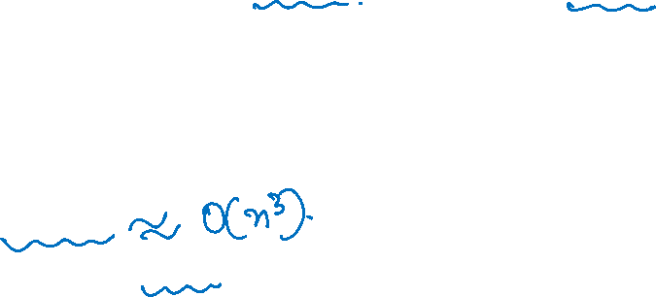
Graph Theory and Its Applications
Community Detection: Girvan–Newman
Time complexity:
Now repeating this process for all n source vertices for m edges gives us the total betweenness for all edges in time O(mn)
Repeat this calculation for each of m edges removed from the network and hence the complete community structure algorithm based on shortest-path betweenness operates in worst-case time O(m²n)
This can be considered as O(n³) on a sparse graph where m scales with n in the limit of large n.

Slide 28
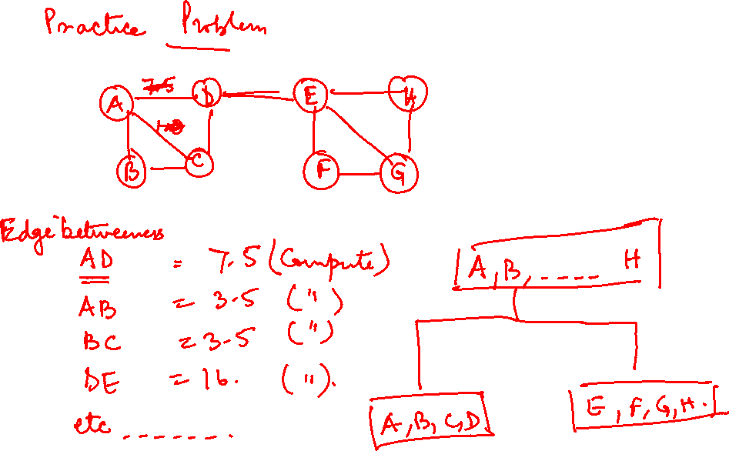

Slide 29
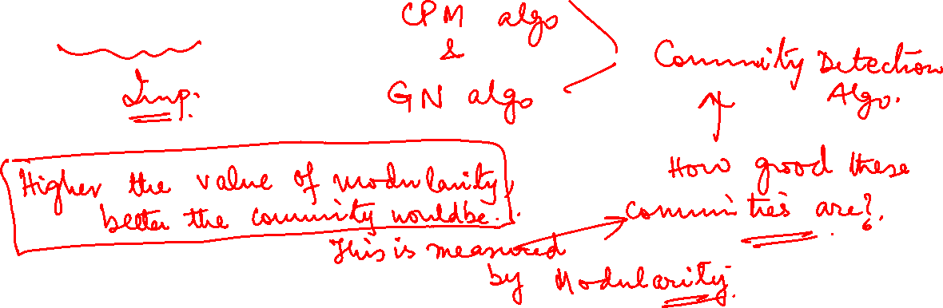
Graph Theory and Its Applications
Modularity

Slide 30
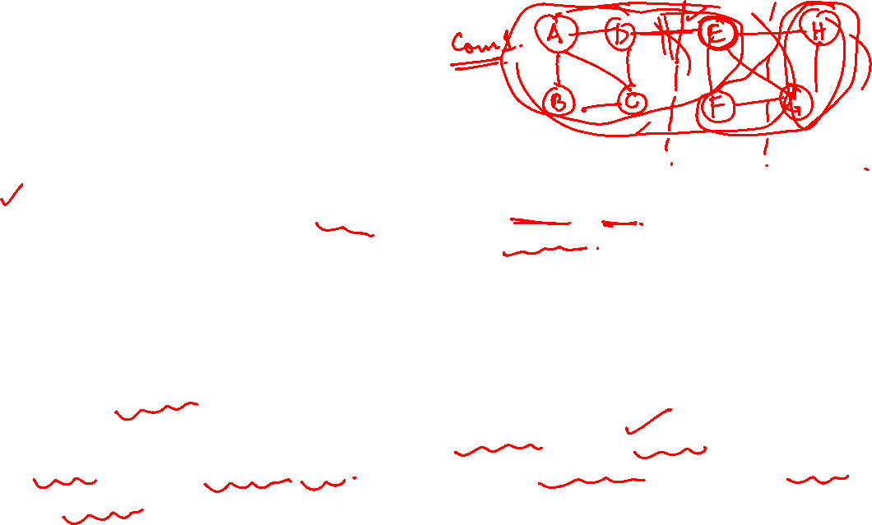
Community detection, modularity and density
Communities are somewhat like clusters with dense population of edges that are not seen in other parts of the graph. It is a soft structure in the graph.
Community detection algorithms try to add a node to a community (based on existing edges) if it improves the community density else not. Addition here means redefine the boundary of the community
Now how to define the quality of the improvement in density ( that can happen by adding a node to an existing community or by combining existing communities) ?
So comes Modularity
Modularity is a measure that defines how likely the community structure found is created at random. Clearly, community structures should be far from random

Slide 31
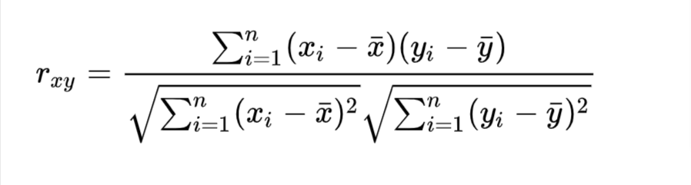
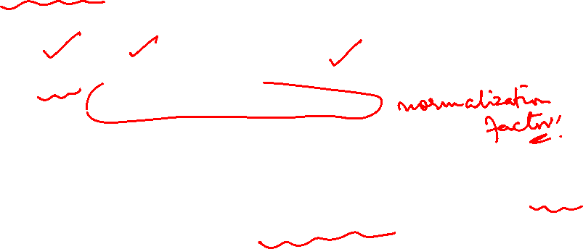
A close parallel
Recall Pearson Correlation coefficient formula
We try to capture the difference between the actual value and the expected (random) one.
The numerator is the real information and the denominator is just the normalization mechanism

Slide 32
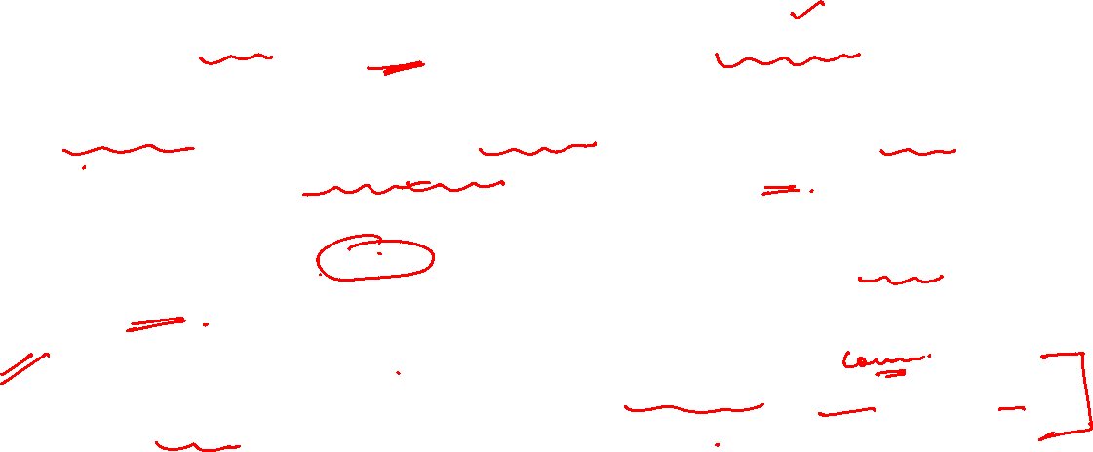
Modularity intuition
Hypothesis : Random network does not have community structure.
Real-world communities are far from random; therefore, the more distant they are from randomly generated communities, the more structure they exhibit.
Modularity defines this distance. Modularity and modularity maximization tries to maximize this distance by optimally defining the communities.
Modularity is the fraction of edges that falls within the given groups minus the expected fraction if edges were distributed at random
Quality function is defined with the above optimization in mind

Slide 33
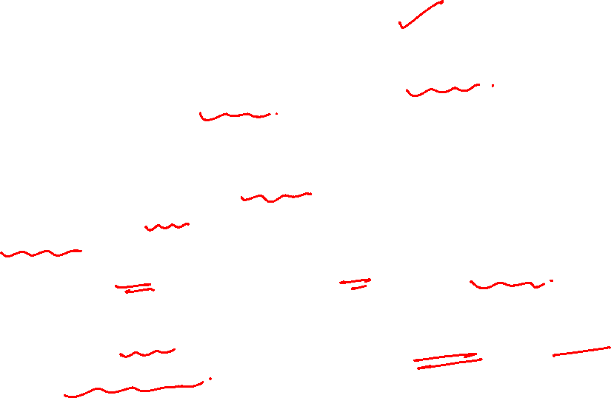
Modularity intuition
Modularity is a goodness factor of partition calculated by a certain algorithm: the greater the value of modularity, better is the structure of the communities found.
Value of modularity lies in (-1,1)
-1 : non modular structure
1 : fully modular
0 : fraction of edges inside the community is like random case
Modularity is positive if the # of edges within groups exceeds the # expected on the basis of chance.

Slide 34
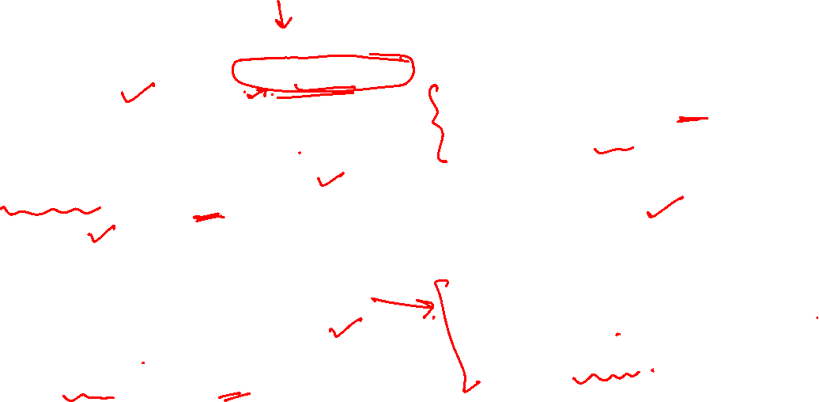
Hypothesis In Modularity based Community Detection
H1: A network’s community structure is
uniquely encoded in its wiring diagram
H4: Random Hypothesis
Randomly wired networks are not expected to have a community structure.
H2: Connectedness Hypothesis
A community corresponds to a connected subgraph.
H3: Density Hypothesis
Communities correspond to locally dense neighborhoods of a network.
H5: Maximal Modularity Hypothesis
The partition with the maximum modularity M for a given network offers the optimal community structure

Slide 35
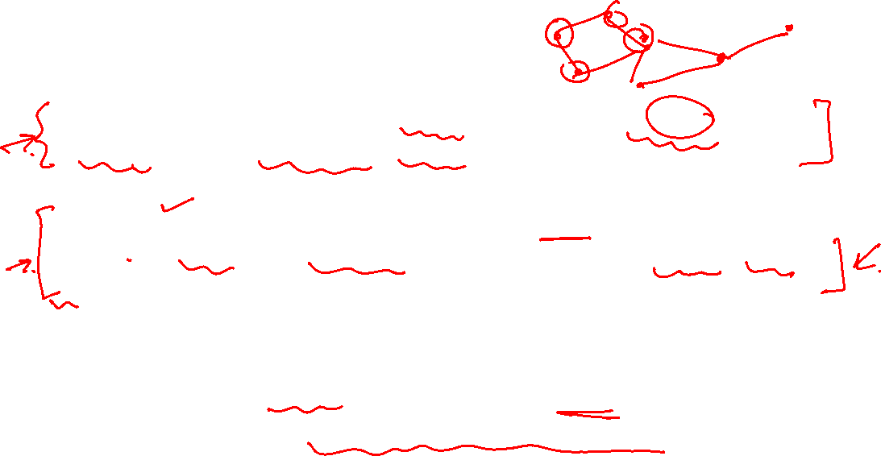
Local Modularity vs. Modularity
Local modularity: is a measure of how well a node and its neighbors form a community in a n/w.
Local modularity compares the number of links between the real network wiring of a subgraph and the randomly rewired subgraph.
Summing up the local modularity across all subgraphs in the graph computes the modularity of the entire network.

Slide 36
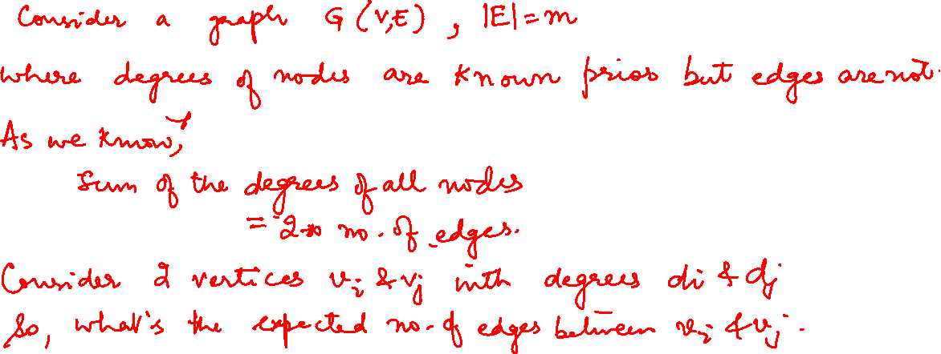
Expected number of edges between two nodes in a graph

Slide 37
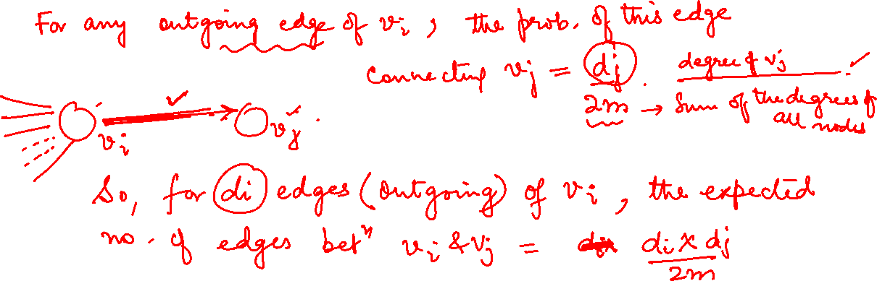
Expected number of edges between two nodes in a graph

Slide 38
Expected number of edges between two nodes in a graph
Consider a graph G(V, E), |E| = m where the degrees are known prior, however, edges are not
By Graph Theory, sum of degrees of all nodes = 2*no of edges
Consider two vertices v_{i} and v_{j} with degrees d_{i} and d_{j}. Now what is an expected number of edges between these two nodes?
For any edge going out of v_{i} randomly, the probability of this edge getting connected to vertex v_{j} is : d_{j} /2m
So, for d_{i} edges coming out of v_{i,} the expected no of edges between v_{i} and v_{j} is d_{i *} d_{j} /2m = d_{i} d_{j} /2m

Slide 39
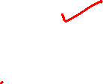
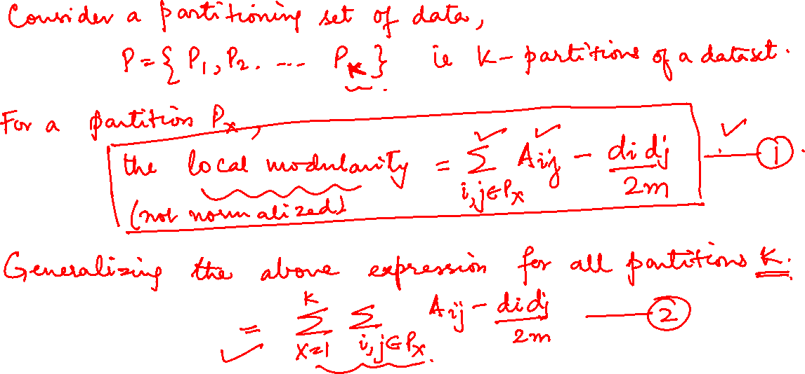
Normalized Expression For Modularity Over All Partitions

Slide 40
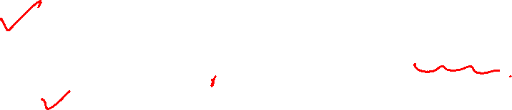
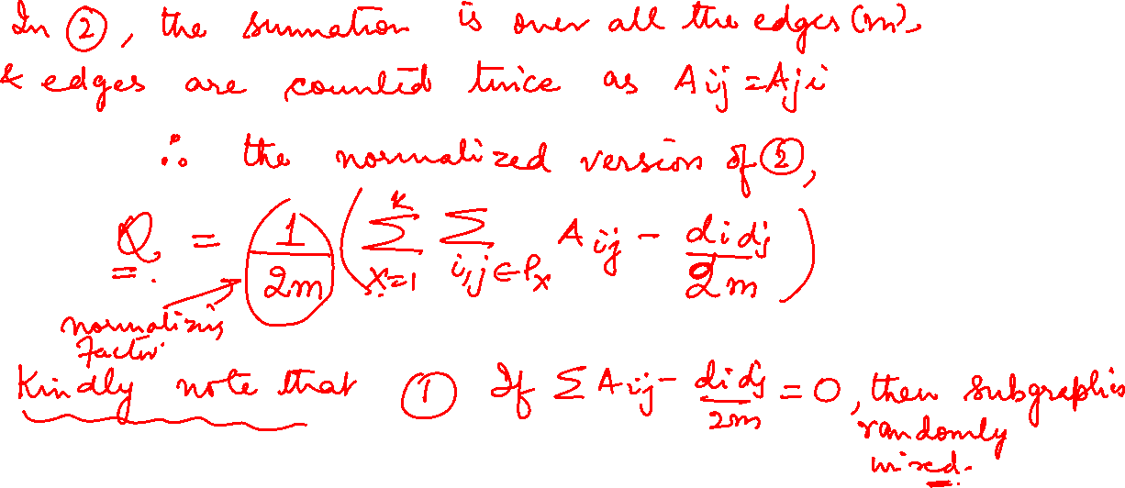
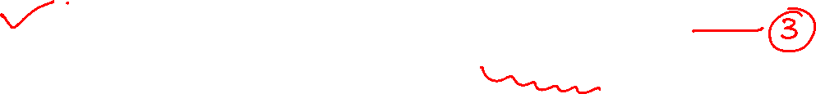
Graph Theory and Its Applications
Normalized Expression For Modularity Over All Partitions

Slide 41
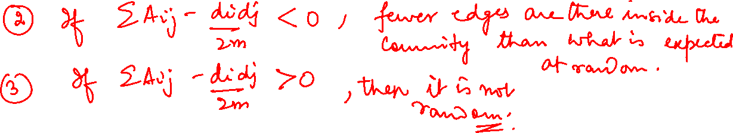

Slide 42
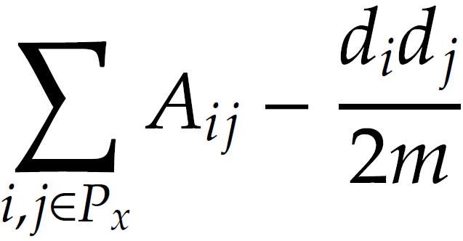
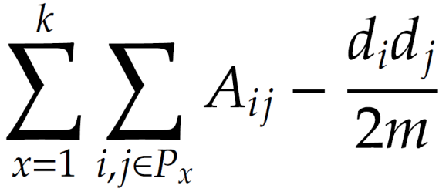
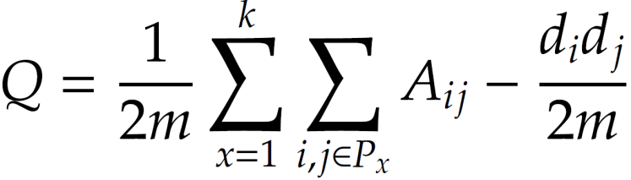
Graph Theory and Its Applications
Normalized Expression For Modularity Over All Partitions
Consider a partitioning of the data, P = (P₁, P₂, P₃, …, P_{k})
For partition P_{x}, this distance
Is the local modularity ( not normalized) :
If this is 0, subgraph is randomly wired
If <0, fewer edges than what is expected at random
If >0, then it is not random
This distance can be generalized for k partitions of the network
The normalized version of the above is defined as Network Modularity
Since summation is over all edges and all edges are counted twice A_{ij} = A_{ji}

Slide 43
Graph Theory and Its Applications
A More Accurate Version for Local Modularity

Slide 44
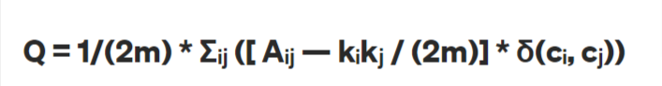
Graph Theory and Its Applications
A More Accurate Version for Local Modularity
Note that in any such partition, node i and j may not necessarily have an edge. So, in the local modularity expression, a pair of nodes will contribute only when they belong to the same community
A more correct formulation should have this delta function i. e. (δ(cᵢ, cⱼ) = 1 if both node i & node j are in same community else 0 i.e. typical delta function will be δ(cᵢ - cⱼ)
Aᵢⱼ = weight of the edge between node ‘i’ & node ‘j’ if weighted graph. In case of unweighted graph - 1 when edge between node i & j exists else 0 .

Slide 45
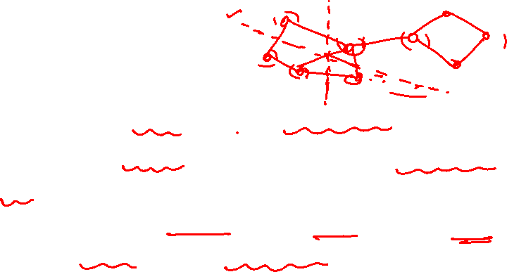
Graph Theory and Its Applications
What is Goal Of This Optimization ?
We are measuring : Local and Network Modularity
Over what the measurement is done : some partitions of the graph each providing local modularity
Idea is to find the best partitioning scheme for this network so that we can maximize the Network Modularity !!
It is really the partition membership of the individual nodes that are getting optimized by measuring the quality parameter (modularity) in each partition !

Slide 46
Graph Theory and Its Applications
(Network) Modularity Maximization is NP Hard
Note : This formula is for undirected and unweighted. Suitable modifications exist !

Slide 47
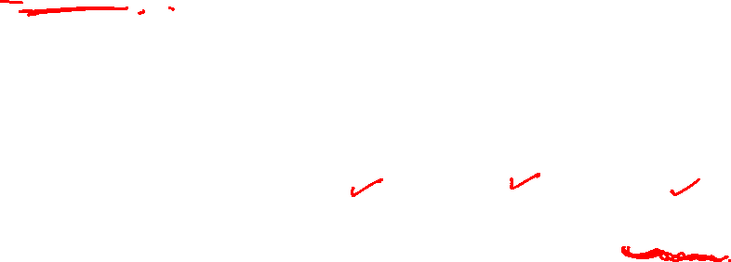
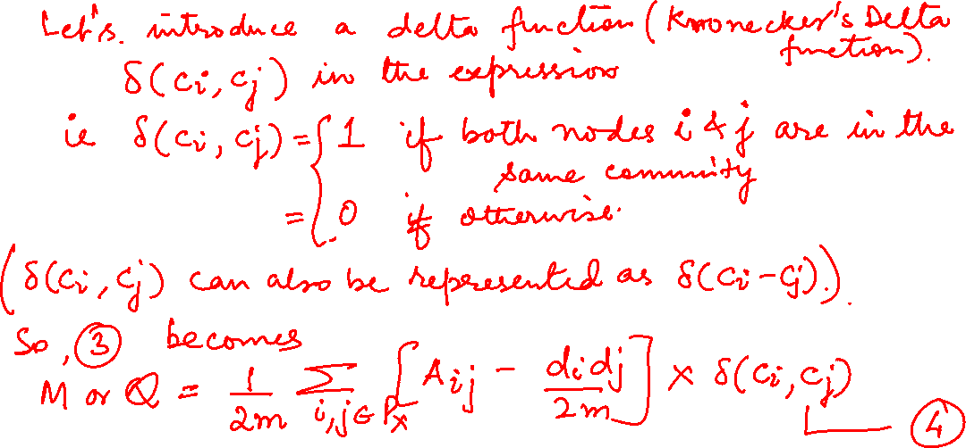
Graph Theory and Its Applications
A Simplified Expression for Modularity
Modularity is a measure associated to a partition

Slide 48
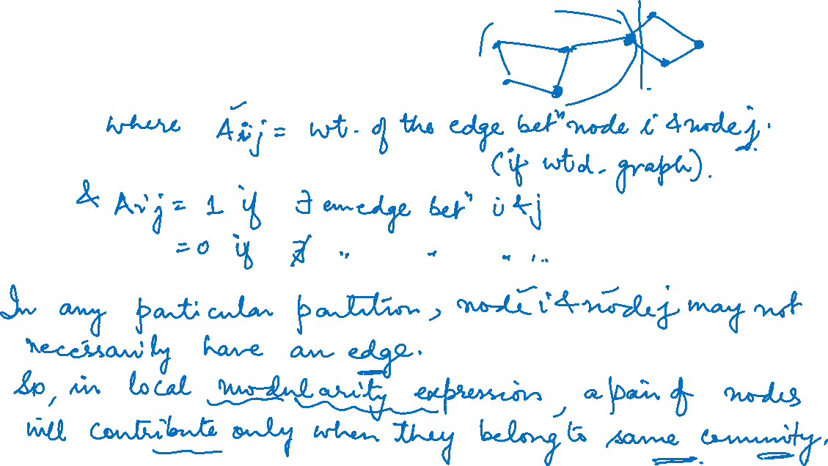
Graph Theory and Its Applications
A Simplified Expression for Modularity
Modularity is a measure associated to a partition

Slide 49
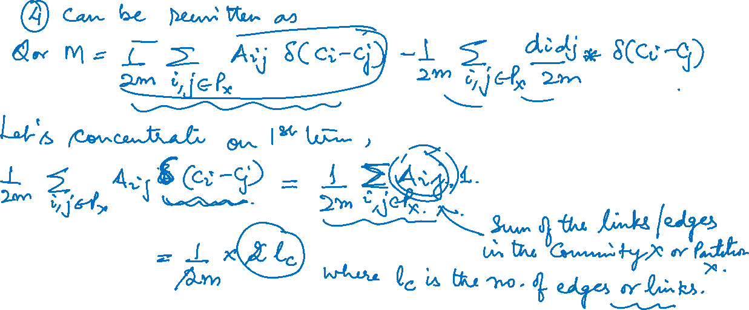
Graph Theory and Its Applications
A Simplified Expression for Modularity
Modularity is a measure associated to a partition

Slide 50

Graph Theory and Its Applications
A Simplified Expression for Modularity
Modularity is a measure associated to a partition

Slide 51


Slide 52


Slide 53


Graph Theory and Its Applications
A Simplified Expression for Modularity - Derivation
Another way of writing M
We can rewrite the first term as
where L_{C} is the number of links within C. In a similar fashion, the second term becomes
Finally we get:
MEJ Newman, PNAS 103 (2006).
A.-L. Barabási, Network Science: Communities.

Slide 54

Graph Theory and Its Applications
Example1 - Modularity Calculation with 2 possible partitions

Slide 55


NETWORK ANALYSIS AND MINING
Example - Modularity Calculation with 2 possible partitions
Consider 2 possible partitions other partition is shown on other slide.

Slide 56

NETWORK ANALYSIS AND MINING
Example - Modularity Calculation with 2 possible partitions

Slide 57


Slide 58

NETWORK ANALYSIS AND MINING
Example - Modularity Calculation with 2 possible partitions

Slide 59


NETWORK ANALYSIS AND MINING
Network Modularity Varies Across Partitions
Optimal partition, that maximizes the modularity.
Sub-optimal but positive modularity.
Negative Modularity: If we assign each node to a different community.
Zero modularity: Assigning all nodes to the same community, independent of the network structure.
Modularity is size dependent
Modularity value varies between -1 and 1.

Slide 60




NETWORK ANALYSIS AND MINING
Which Partition Is Providing Optimum Modularity ?
A.-L. Barabási, Network Science: Communities.

Slide 61


NETWORK ANALYSIS AND MINING
Limits of Modularity – No Clear Maxima
Modularity plays a significant role in community identification, but there are some limitations also.
Resolution Limit
The resolution limit in modularity for community detection refers to the difficulty of detecting communities that are smaller than a certain size due to the limitations of the modularity metric.
Modularity maximization compels small communities to merge into larger ones and thus the network’s modularity changes with $∆Q_{AB} or ∆M_{AB}$.
A.-L. Barabási, Network Science: Communities.

Slide 62
NETWORK ANALYSIS AND MINING
Resolution Limit of Modularity
The resolution limit of modularity actually depends on the degree of interconnectedness between pairs of communities and can reach values of the order of the size of the whole network.
The resolution limit of modularity does not depend on particular network structures.
It results only from the comparison between the number of links between interconnected communities and the total number of links of the network.

Slide 63

NETWORK ANALYSIS AND MINING
Resolution Limit of Modularity

Slide 64

NETWORK ANALYSIS AND MINING
Resolution Limit of Modularity

Slide 65

NETWORK ANALYSIS AND MINING
Resolution Limit of Modularity

Slide 66

NETWORK ANALYSIS AND MINING
Resolution Limit of Modularity

Slide 67




NETWORK ANALYSIS AND MINING
Limits of Modularity – No Clear Maxima
Even max modularity
Zone has no peaks !
m = 10*24+24 = 264,
$k≤23$ . Here node degree = 4. Hence an increase !
A.-L. Barabási, Network Science: Communities.

Slide 68

NETWORK ANALYSIS AND MINING
Limits of Modularity – No Clear Maxima
First, it forces together small weakly connected communities.
Second, networks lack a clear modularity maxima, developing instead a modularity plateau containing many partitions with hard to distinguish modularity.
A.-L. Barabási, Network Science: Communities.

Slide 69
NETWORK ANALYSIS AND MINING
Attempts to Modify Modularity Expression
Expected connections, a model
can take into account weights
can take into account directions
can take into account attributes or space
S. Fortunato, Phys. Rep. 486 (2010)
S. Fortunato, Phys. Rep. 486 (2010)
P. Expert el al., PNAS 108 (2011)

Slide 70


NETWORK ANALYSIS AND MINING
Resolution Limit For Modularity
Consider two partitions A and B of the network. In partition 1, A and B are taken as separate modules, and in partition 2, they are considered as a single community. . The subdivision of the rest of the network, M0, is arbitrary but identical in both partitions.
$∆$Q = Q2 - Q1
A
B
k_{A} and k_{B} total degree in A and B, L_{A} and L_{B} are links inside A and B, L_{AB} are links between A ,B
We merge A and B to maximize modularity.
If and
Assuming
So, if K is substantially less, then by merging two communities, modularity will increase and we end up merging them. Modularity has a resolution limit, as it cannot detect communities smaller than this size.

Slide 71



NETWORK ANALYSIS AND MINING
Modularity in Available Software
Gephi
R assigns self-loops to nodes to increase or decrease the aversion of nodes to form communities
NetworkX
Finds the partition that maximizes modularity (considers weights and direction)
Calculates the modularity of the partition you provide

Slide 72

NETWORK ANALYSIS AND MINING
Group based community detection using greedy optimization of modularity – various algorithms

Slide 73

NETWORK ANALYSIS AND MINING
Greedy Approach for Modularity Optimization
The expectation that partitions with higher modularity corresponds to partitions that more accurately capture the underlying community structure prompts the following hypothesis:
H5: Maximal Modularity Hypothesis
For a given network the partition with maximum modularity corresponds to the optimal community structure.
The maximum modularity hypothesis is the starting point of several community detection algorithms, each seeking the partition with the largest modularity.

Slide 74

NETWORK ANALYSIS AND MINING
Greedy Approach for Modularity Optimization
A greedy algorithm, which iteratively joins nodes if the move increases the new partition’s modularity.
Step 1. Assign each node to a community of its own. Hence we start with N communities.
Step 2. Inspect each pair of communities connected by at least one link and compute the change in modularity ΔM if we merge these two communities.
Step 3. Identify the community pairs for which ΔM is the largest and merge them. Note that modularity of a particular partition is always calculated from the full topology of the network.
Step 4. Repeat step 2 until all nodes are merged into a single community.
Step 5. Select the partition for which M is maximal.

Slide 75

NETWORK ANALYSIS AND MINING
Greedy Approach is a Hill Climbing Approach
Essentially a hill climbing algorithm (Hill climbing algorithm is a local search algorithm which continuously moves in the direction of increasing elevation/value to find the peak of the mountain or best solution to the problem.
It terminates when it reaches a peak value where no neighbor has a higher value).
It is an agglomerative algorithm (like hierarchical clustering)

Slide 76

NETWORK ANALYSIS AND MINING
Computational Complexity Using Greedy Approach
Computational Complexity is coming because of step 2 ( too many useless operations) !
Step 1-2 (calculation of ΔM for L links ):
Step 3 (matrix update):
Step 4 (N-1 community merges):
for sparse networks
An improvement from O(N³) !
MEJ Newman, PRE 69 (2004).
A.-L. Barabási, Network Science: Communities.

Slide 77

NETWORK ANALYSIS AND MINING
Fast Algorithm for Detecting Community Structure ( Newman)
Girvan Newman algorithm performs poorly on large sparse graph i.e. O(n³)
The original Girvan Newman paper mentions that “As a practical matter, we calculate the betweenness by using the fast algorithm of Newman (25)”

Slide 78


NETWORK ANALYSIS AND MINING
Girvan Newman Algorithm With Modularity – Newman’s Fast Algorithm
The algorithm will stop when the new modularity is no longer greater than the modularity from the previous iteration.
Similar to Agglomerative Hierarchical Clustering.
One caveat to this algorithm is that it is difficult to find smaller communities. One can use this algorithm only to detect larger community structures and then analyze the detected community for sub-communities
Process of this algorithm can be represented as Dendrogram and the cut through this represents no of community in that option. We can choose the option by evaluating modularity at each option
The worst-case running time of the algorithm is O((m + n)n), or O(n²) on a sparse graph.
Modularity Q is as :

Slide 79

NETWORK ANALYSIS AND MINING
Modularity optimization (Clauset, Newman , Moore)
Yet another attempt to address the Time Complexity in Girvan Newman algorithm

Slide 80


NETWORK ANALYSIS AND MINING
Modularity optimization (Clauset, Newman, Moore)
Similar greedy optimization as before ( Newman Fast Algorithm)
Step 1 : Start with n distinct vertices in n distinct clusters
Step 2: At each step, join two communities that produce the largest increase in the value of Q (or M)
Repeat step 2 until only one community remains
Improvement by using some data structure and some short cut in the optimization procedures
Time Complexity O( md Log n) where d is the depth of dendrogram representing community structure
For sparse network, m $\sim$n . Also for hierarchical community structure, d$\sim$ log n
For such network, this gives O(n log²n) i.e. linear log n time
Notes:
~

Slide 81



NETWORK ANALYSIS AND MINING
Modularity optimization (Clauset, Newman, Moore)
This algo is faster than Newman Greedy Algo bcoz of the data structures used.
In this algo 3 data structures are maintained:
1. A sparse matrix containing $∆Q_{ij}$for each pair of i, j of communities with at least one edge between them.
(Each row of the matrix is maintained as a balanced binary tree: so that elements can found and inserted in O( log n) time and a max-heap : so that the largest elt. can be found in constant time)
A max-heap H containing the largest let of each row of the matrix $∆Q_{ij}$ along with the labels I, j of the corresponding pair of communities.
An ordinary vector array with element a_{i.}

Slide 82


NETWORK ANALYSIS AND MINING
Modularity optimization (Clauset, Newman, Moore)
The CNM algorithm is as follows:
Compute the initial values of $∆Q_{ij}$ and $a_{i } as described. Populate the max−heap with the largest element of each row of the matrix ∆Q_{}$
Select the largest $∆Q_{ij}$ from H, join the corresponding communities, update the matrix $∆Q,$the heap H and $a_{i }$ and increment Q by $∆Q$.
Repeat step 2 until only one community is left.
Complexity is O(n log²n) i.e. linear log n time

Slide 83

NETWORK ANALYSIS AND MINING
Louvain method by Blondel et al.
Louvain method written by Blondel et. al. Louvain method is still considered to be one of the fastest disjoint community detection technique.
We use the same definition of Q as In Newman’s Fast Algorithm
But uses an even faster greedy optimization than CNM algorithm

Slide 84

SOCIAL NETWORK ANALYTICS
Louvain Algorithm Vs. Clauset Newman Moore
The Louvain algorithm is a greedy algorithm that is very similar to the Clauset-Newman-Moore (CNM) Algorithm.
The initialization is the same i.e. each node is a community to start with.
CNM
Louvain
The pair of communities that maximize the increase in modularity are combined.
No community aggregation step, and continually combine pairs of communities that maximize the increase in modularity until we can no longer combine communities.
A single node is moved from one community to another.
The community aggregation stage is introduced.

Slide 85

NETWORK ANALYSIS AND MINING
Louvain method by Blondel et al.
Louvain Algorithm consists of 2 phases:
1st Phase: Modularity optimization to detect community
2nd Phase: Community aggregation

Slide 86

NETWORK ANALYSIS AND MINING
Louvain method by Blondel et al.
First phase (Modularity optimization to detect community )
Assign each node to it's own community.
Iterate over each node, calculating the change in modularity that would occur if it were removed from it's current community and put in a connected community. Essentially for every node, every neighboring node is considered.
Move it to the community that produces the biggest increase in modularity.
Repeat step 2 until we can't increase modularity anymore.

Slide 87

NETWORK ANALYSIS AND MINING
Louvain method by Blondel et al.
Second phase (Community aggregation ):
Super nodes are created to represent each detected community in first phase and create a new network.
The edge weight between the nodes representing two communities is just the sum of the edge weights between the nodes of community 1 and community2 for directed graph and edge count for undirected graph. This step also generates self-loops which are the sum of all links inside a given community, before being collapsed into one node.
Perform the first phase on this new network. That is, we're calculating communities of communities.
We then repeat these two phases until no further change in communities is observed

Slide 88


SOCIAL NETWORK ANALYTICS
Louvain Algorithm
The Louvain algorithm starts from a singleton partition in which each node is in its own community
(a). The algorithm moves individual nodes from one community to another to find a partition
(b). Based on this partition, an aggregate network is created
(c). The algorithm then moves individual nodes in the aggregate network
(d). These steps are repeated until the quality cannot be increased further.

Slide 89




Louvain Algorithm Example from Paper
Links of node 0 inside green community: 3
Links of node 1 inside green community: 2
Links of node 2 inside green community: 4
Links of node 4 inside green community: 3
Links of node 5 inside green community: 2

Slide 90

SOCIAL NETWORK ANALYTICS
Louvain Algorithm Example from Paper
We started off with separate communities for each node
After iterating over nodes & calculating modularity by changing communities for nodes, we finally got 4 communities (Red, Blue, Sky Blue & Green)
In the new graph formed, we now have 4 nodes (representing the 4 communities found) with edge weights as aggregation .
Again the entire cycle of finding communities using Modularity starts in this new graph now where we are able to club these 4 communities into 2 )
As no further communities are found, therefore we end up with 2 communities.

Slide 91
SOCIAL NETWORK ANALYTICS
Community Detection: Louvain Algorithm
The method is a greedy optimization method that attempts to optimize the "modularity" of a partition of the network.
The exact computational complexity of the method is not known, the method seems to run in time O(n log n) with most of the computational effort spent on the optimization at the first level.

Slide 92
NETWORK ANALYSIS AND MINING
Community Detection Big Picture
Dr. Arti Arya
Department of Computer Science and Engineering

Slide 93

NETWORK ANALYSIS AND MINING
Member based Vs Group Based Community Detection
Earlier, for detecting component and sub-structure , we talked about top down and bottom up views
Top down ( component , giant component etc.)
Bottom up ( cliques and relaxation of cliques)
Community Detection
Member based – overlaps with bottom up substructure discussion we had earlier . This is based on member’s characteristics
Group Based – this is based on density of interaction in the group

Slide 94


NETWORK ANALYSIS AND MINING
Member based Vs Group Based Community Detection
Member based community based on colours
Group based community based on density of interactions

Slide 95

NETWORK ANALYSIS AND MINING
Member Based Community
Intuition : nodes having same characteristics tend to form a community.
Example- in the 4-cycle graph, every node has degree=2.
Node degree i.e. K clique, K clan , CPM (using n-clique as seed )
Node reachability i.e. K plex, K core
Node similarity i.e. once a similarity measure is established, one can estimate distance and apply conventional clustering algorithms such as hierarchical clustering. The similarity can be structural or attribute based

Slide 96



NETWORK ANALYSIS AND MINING
Vertex similarity based on neighborhood structure – Jaccard vs. Cosine
Generally, similarity is bounded in [0,1]
Measure of node similarity can be defined in terms of node neighbourhood as:

Slide 97

NETWORK ANALYSIS AND MINING
Criticism
Node itself is excluded in neighbourhood definition.
Hence, the nodes that have no common neighbours will have 0 similarity. To fix this, node itself can be considered
A more interesting approach of measuring the similarity is to compare similarity with the expected value of the same when the nodes pick their neighbours randomly .
Pearson Correlation Coefficient

Slide 98


NETWORK ANALYSIS AND MINING
Pearson correlation coefficient as similarity measure
In terms of degree, similarity between v_{i} and v_{j} ,
The co-variance is normalized as below i.e.

Slide 99
NETWORK ANALYSIS AND MINING
Regular Equivalence Instead of Structural Equivalence
Concept of structural equivalence i.e. in terms of the similarity of their neighborhood
two members of the football teams in two countries have no neighbor in common but have similar neighborhoods
Regular equivalence is a generalization of structural equivalence
We are skipping the details here..

Slide 100

NETWORK ANALYSIS AND MINING
Group based community detection
Group oriented methods : based on group properties
Girvan-Newman algorithm (edge betweenness is used and it can give hierarchical community)
Modularity maximization-based approaches such as Louvain algorithm
Spectral clustering
Label Propagation Algorithm based Community detection There are other approaches as well..

Slide 101

Graph Theory and its Applications
Evaluation
Dr. Arti Arya
Department of Computer Science and Engineering

Slide 102


How to evaluate ?
When we are given objects of two different kinds, the perfect communities would be the case when objects of the same type are in the same community.
The communities here are shown with True label of members
Evaluation with ground truth ( some test data is there)
Evaluation without ground truth

Slide 103

Evaluation with the ground truth
When ground truth is available, we have at least partial knowledge of what communities should look like.
We are given the correct community (clustering) assignments.
Measures
Precision and Recall, or F-Measure
Purity

Slide 104





Purity
In purity, we assume the majority of a community represents the community
The purity is then defined as the fraction of instances that have labels equal to the community’s majority label
where k is the number of communities, N is the total number of nodes, L_{j} is the set of instances with label j in all communities, and C_{i} is the set of members in community i.

Slide 105


Slide 106

Purity is not a Precise Measure always
Purity can be easily manipulated to generate high values;
consider when nodes represent singleton communities (of size 1)
when we have very large pure communities (ground truth = majority label).
In both cases, purity does not make sense because it generates high values.

Slide 107





Precision and Recall
$\text{Precision}\text{ =}$ $\frac{\text{Relevant} \text{and} \text{retrieved}}{\text{Retrieved}}$
$\text{Recall}\text{ =}$ $\frac{\text{Relevant} \text{and} \text{retrieved}}{\text{Relevant}}$
Community detection can be considered a problem of assigning all similar nodes to the same community.
In the simplest case, any two similar nodes should be considered members of the same community.
True Positive (TP) :
when similar points are assigned to the same communities
This is considered a correct decision.
True Negative (TN) :
when dissimilar points are assigned to different communities
This is considered a correct decision
False Negative (FN) :
when similar points are assigned to different communities
This is considered an incorrect decision
False Positive (FP) :
when dissimilar points are assigned to the same communities
This is considered an incorrect decision

Slide 108


Precision and recall
For TP, we need to compute the # of similar pairs that are in the same community.
For FP, we need to compute dissimilar pairs that are in the same community.
For FN, we compute the similar pairs that are in different communities.
For TN, we compute the number of dissimilar pairs in the different communities.

Slide 109

Precision and recall

Slide 110

Precision and Recall

Slide 111

Precision and Recall

Slide 112

Evaluating Without Ground Truth - with semantics
A simple way of analyzing detected communities is to analyze other attributes (posts, profile information, content generated, etc.) of community members to see if there is a coherency among community members
For example, if there is text data as attribute available for each node, to help analyze these communities, one can use word frequencies, do word cloud or do topic model or do key word / key phrase extraction.
These things may be considered as better attributes

Slide 113
Evaluating Without Ground Truth - with Clustering Quality Measures
We can use the usual clustering quality measures as well, specifically intrinsic measures such as Silhouette Coefficient, inter and intra cluster similarity
But they are not always very effective

Slide 114


Intrinsic Measure for Clustering Quality : Silhouette Coefficient
Silhouette Coefficient or silhouette score is a metric used to calculate the goodness of a clustering technique. Its value ranges from -1 to 1.
1 Means clusters are well apart from each other and clearly distinguished.
0: Means clusters are indifferent, or we can say that the distance between clusters is not significant.
-1: Means clusters are assigned in the wrong way.
Silhouette Score = (b-a)/max(a,b) where
a= average intra-cluster distance i.e. the average distance between each point within a cluster.
b= average inter-cluster distance i.e. the average distance between all clusters.

